Slide 1
BANK LOAN ANALYSIS

Slide 2
PROBLEM STATEMENT
Bank loans play a vital role in supporting individuals and businesses by providing necessary financial assistance to achieve their goals. However, it is equally important for borrowers and lenders to thoroughly understand the associated terms, costs, and responsibilities to ensure sound financial decisions and risk management.
This project involves the development of a comprehensive Bank Loan Analysis Dashboard using Power BI, supported by SQL for data validation and quality checks. The dashboard is designed to present key performance indicators (KPIs) and essential loan metrics derived from the dataset, offering valuable insights into loan distribution, repayment status, default trends, customer demographics, and more.
The objective is to provide a clear and interactive overview tailored for business stakeholders or banking clients, enabling them to monitor loan performance, identify potential risks, and make data-driven decisions effectively.

Slide 3
DASHBOARD 1 : SUMMARY
KEY PERFORMANCE INDICATORS (KPIs):
Total Loan Applications
Total Funded Amount
Total Amount Received
Average Interest Rate
Average Debt-to-Income Ratio (DTI)
GOOD LOAN vs BAD LOAN KPI’s
GOOD LOAN
BAD LOAN
Good loan application percentage
Good Loan applications
Good Loan Funded Amount
Good Loan Received Amount.
Bad loan application percentage
Bad Loan applications
Bad Loan Funded Amount
Bad Loan Received Amount.

Slide 4
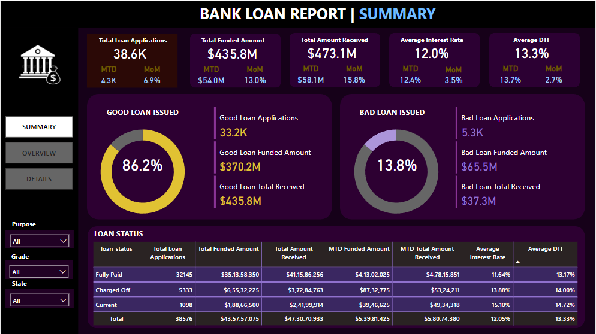

Slide 5
DASBOARD 2: OVERVIEW
Monthly Trends by Issue Date : To identify seasonality and long-term trends in lending activities
Regional Analysis by State : To identify regions with significant lending activity and assess regional disparities
Loan Term Analysis : To allow the client to understand the distribution of loans across various term lengths.
Employee Length Analysis : How lending metrics are distributed among borrowers with different employment lengths, helping us assess the impact of employment history on loan applications.
Loan Purpose Breakdown : Will provide a visual breakdown of loan metrics based on the stated purposes of loans, aiding in the understanding of the primary reasons borrowers seek financing.
Home Ownership Analysis : For a hierarchical view of how home ownership impacts loan applications and disbursements.
Metrics shown: 'Total Loan Applications,' 'Total Funded Amount,' and 'Total Amount Received'

Slide 6
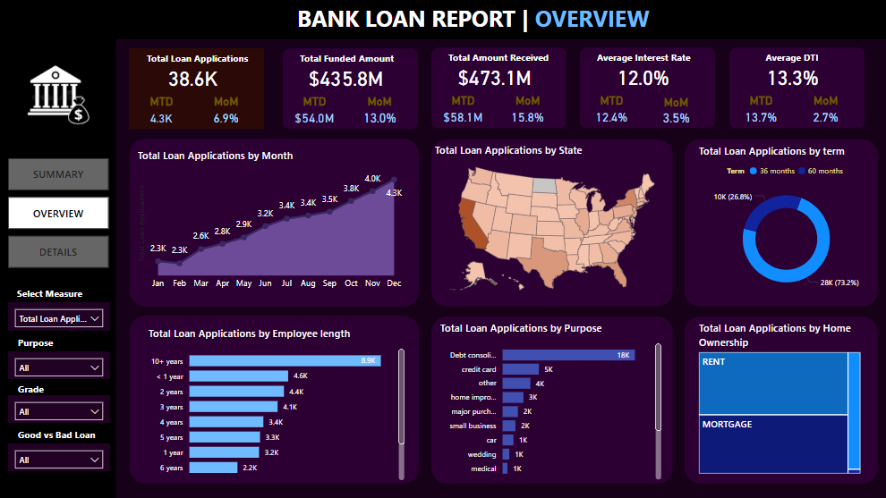

Slide 7
DASBOARD 3: DETAILS
'Details Dashboard' that provides a consolidated view of all the essential information within the loan data. The Details Dashboard aims to offer a holistic snapshot of key loan-related metrics and data points, enabling users to access critical information efficiently.
The primary objective of the Details Dashboard is to provide a comprehensive and user-friendly interface for accessing vital loan data. It will serve as a one-stop solution for users seeking detailed insights into our loan portfolio, borrower profiles, and loan performance.

Slide 8
